Slide 1
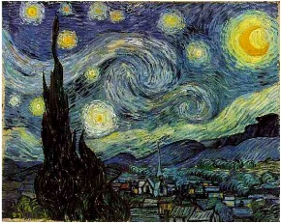
Vincent Van Gogh
A Starry Night
Art Appreciation Lesson

Slide 2
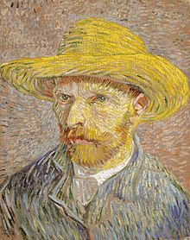
Vincent Van Gogh
Born in the Netherlands on March 30, 1853
Died July 29, 1890 at the young age of 37
Van Gogh’s brother, Theo, suggested he become a painter after Van Gogh had attempted careers as an art dealer, book seller, teacher, and pastor.
In his late twenties, he began his painting career and produced over 2100 artworks in a period of just over ten years.
Only sold ONE painting in his lifetime
Notes:
His father was a minister and mother was an artist. Started school at age 7 but only went for one year. After that he was home schooled by his sister. He was one of 6 children and was very close to his brother Theo. He went away to boarding school at age 13. Although he started drawing at a young age he did not decide to paint until age 27.

Slide 3
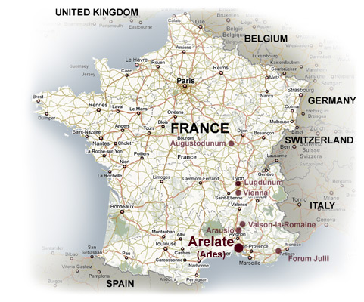
Vincent Van Gogh
In 1886, Van Gogh moved to Paris, France to study the impressionist painters, and later moved to Arles, France to live with other artists and devote his days to painting.

Slide 4
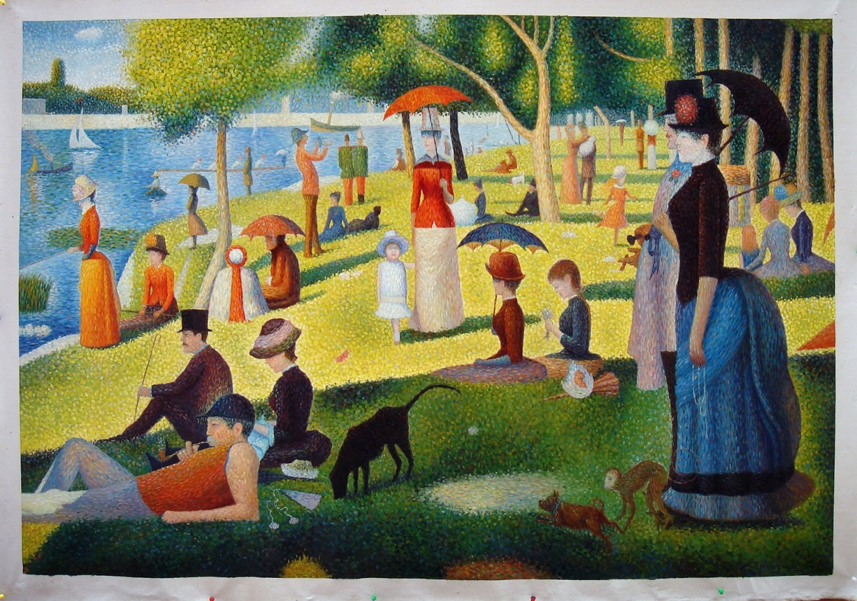
Vincent Van Gogh
Characteristics of impressionist painting are: bold vibrant colors, visible brush strokes, depictions of ordinary life scenes, use of light reflection, and the inclusion of movement in the painting.
A Sunday Afternoon on the Island of La Grande Jatte, George Seurat impressionist

Slide 5
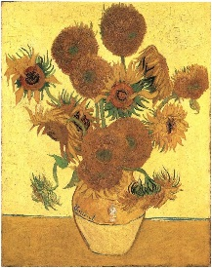
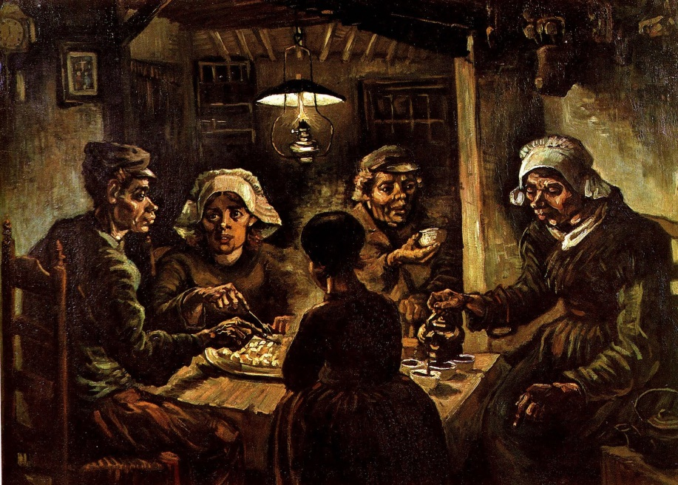
Vincent Van Gogh
In his early career, his paintings were dark but after moving to France and studying with the impressionists, he began to use the bright, vibrant colors for which he is known.
The Potato Eaters, 1885
Sunflowers, 1888

Slide 6
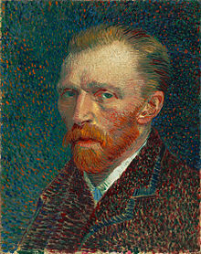
Vincent Van Gogh
Pointillism – a technique of painting in which small dots of pure (unmixed) color are applied in patterns to form an image
Here is a Self Portrait, created in 1887 by Van Gogh using the Pointillist technique.
He used oil paints.

Slide 7
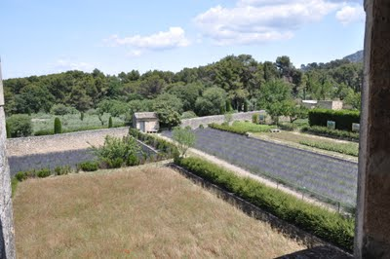
Vincent Van Gogh
1889 - Van Gogh decided to go to a hospital in Saint-Remy, France. There, he would look out the window at the view and paint.
The view today from Van Gogh’s hospital room at
Saint-Paul Hospital, Saint-Remy, France.
Notes:
Van Gogh suffered from poor physical and emotional health. He was very sad or angry much of the time. Contributors to that emotional upset were the fact that many times he would not eat or sleep when working on a painting.
It is from that hospital room, in 1889, that he painted his most famous painting, Starry Night. Starry Night is one of the most well known images in modern culture as well as being one of the most replicated and sought after prints.

Slide 8
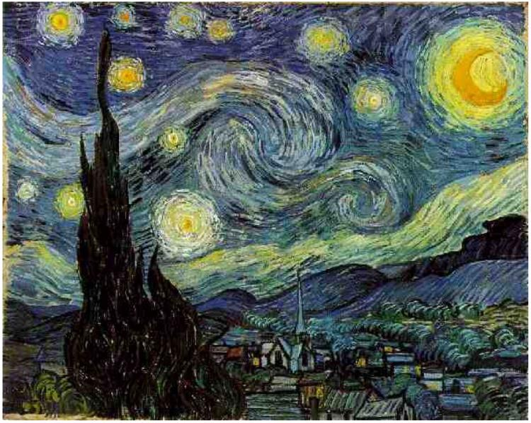
Starry Night, Van Gogh, 1889, Oil Paints on Canvas
Notes:
What is this a painting of? What do you see in the painting? Is the scene realistic or an artists impression? (wind, swirls, circles, textures, shapes, loose brush strokes) What colors do you see?
What do you think of? What kind of emotions do you have about the painting? What kind of emotion do you think the artist had when painting this piece? Van Gogh was a man of very extreme emotions. Sometimes you can tell that when looking at a painting. But we know the most about his emotions from letters he wrote to his brother Theo. He was so devoted to his art that he would sometimes paint furiously through the night and refuse to eat or sleep. He would also spend all his money on art supplies. And he would trade his painting for more art supplies. His ill physical health and his eating and sleeping habits made him sad, and angry a lot of the time.
What is this a painting of? What do you see in the painting? Is the scene realistic or an artists impression? (wind, swirls, circles, textures, shapes, loose brush strokes) What colors do you see?
What do you think of? What kind of emotions do you have about the painting? What kind of emotion do you think the artist had when painting this piece? Van Gogh was a man of very extreme emotions. Sometimes you can tell that when looking at a painting. But we know the most about his emotions from letters he wrote to his brother Theo. He was so devoted to his art that he would sometimes paint furiously through the night and refuse to eat or sleep. He would also spend all his money on art supplies. And he would trade his painting for more art supplies. His ill physical health and his eating and sleeping habits made him sad, and angry a lot of the time.

Slide 9
A Starry Night
Movement, energy and light in the painting – by using color, swirling images, lines of color in rings and circles, and outlining the images in black
Lots of bright yellow and orange color against the blue sky. Thickly applied paint creates a rhythmic effect, called Impasto Technique.
Depth
Massive flame-like cypress tree or bush structure in the foreground is near
Town with church and steeple is smaller, far away

Slide 10
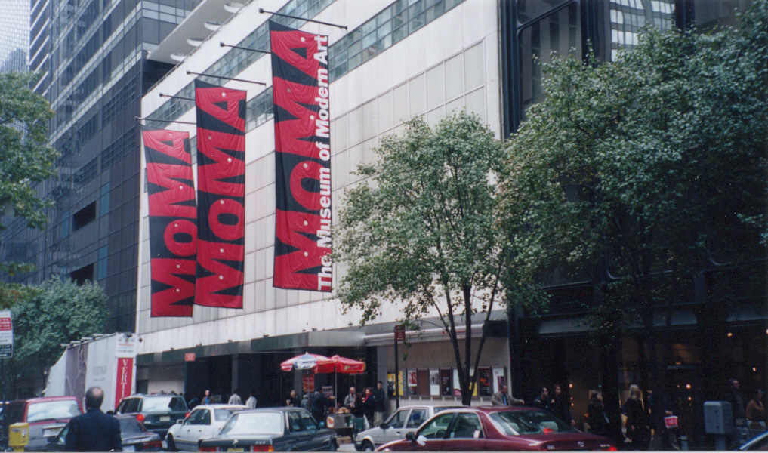
Vincent Van Gogh, Starry Night
Starry Night resides at the Museum of Modern Art in New York City.
Although he created over 2100 works of art, he sold only one in his lifetime.
In 1990, Van Gogh’s painting, Portrait of Dr. Gachet, sold for 82.5 million dollars.

Slide 11
Create your own Starry Night
Step 1 – draw your landscape scene
Step 2 – add a small village or church scene (small=faraway)
Step 3 – add the large tree like shape – large=near
Step 4 – add your stars and moon, either draw them or use stickers
Step 5 – add your swirls and rings and color!

