Slide 1
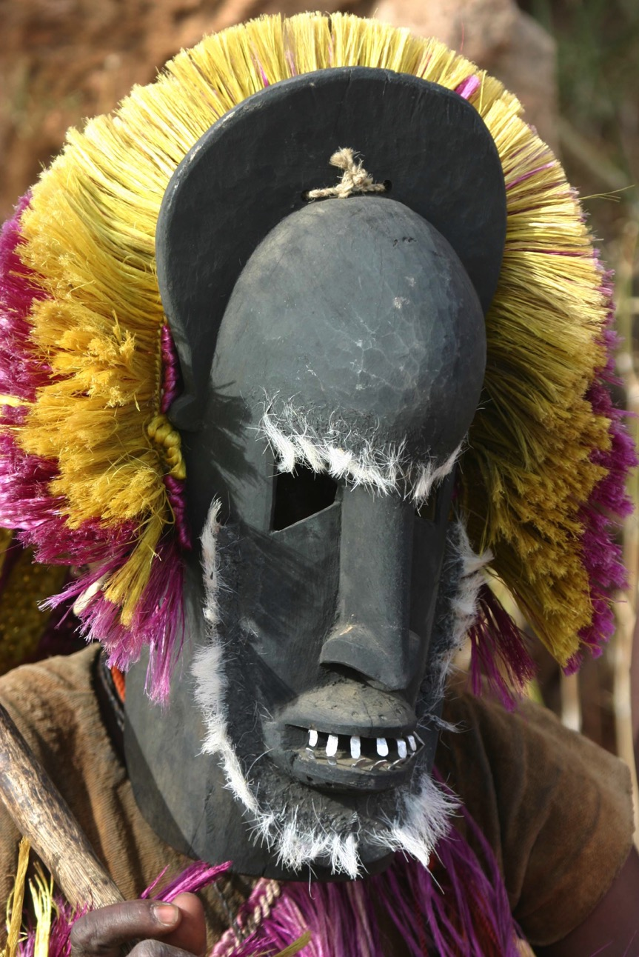
AFRICAN TRIBAL MASKS

Slide 2
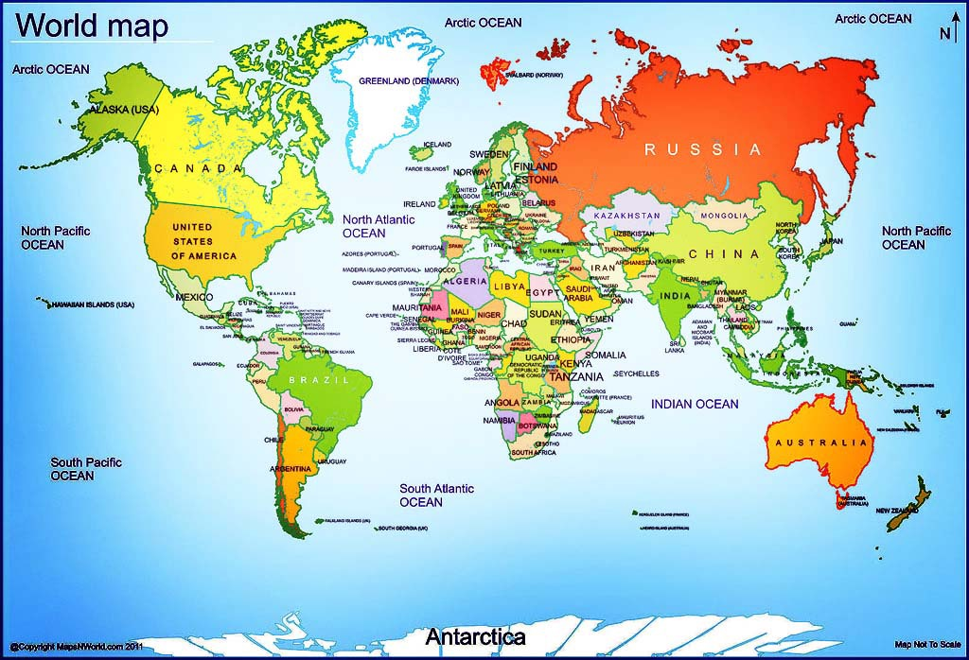
Where is Africa?
Africa is the second largest continent on the globe
61 countries.

Slide 3
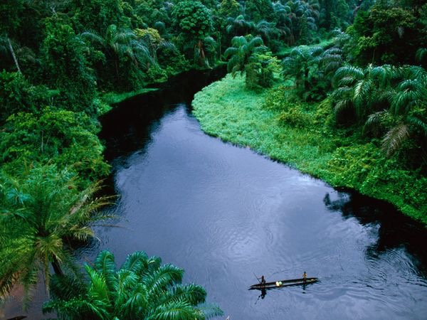
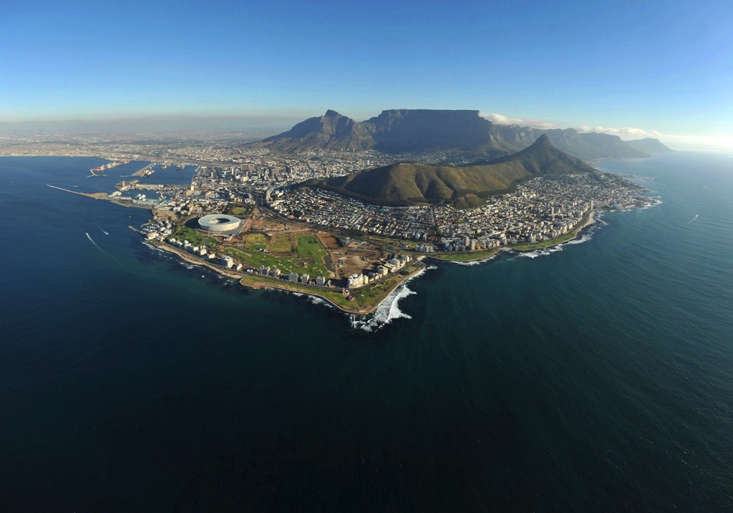
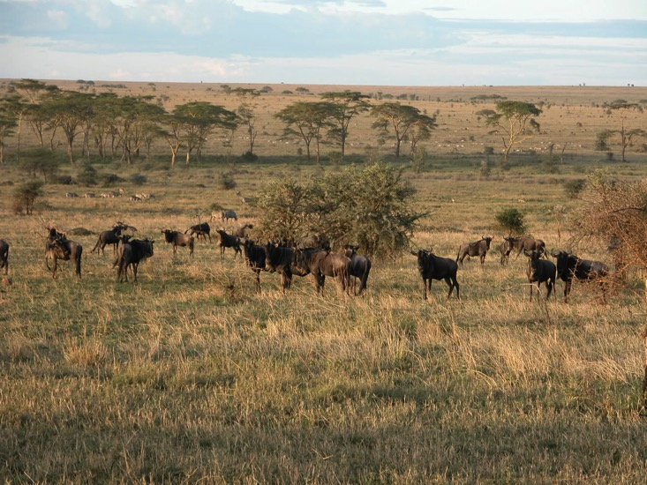
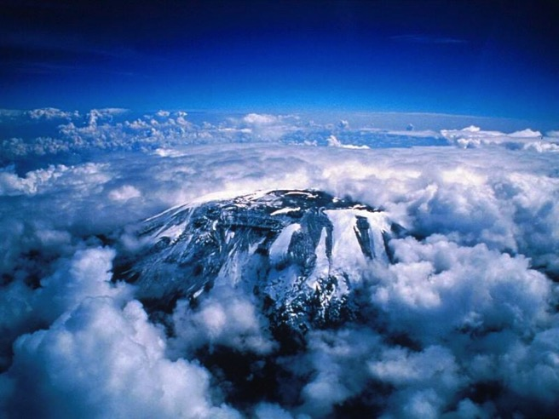
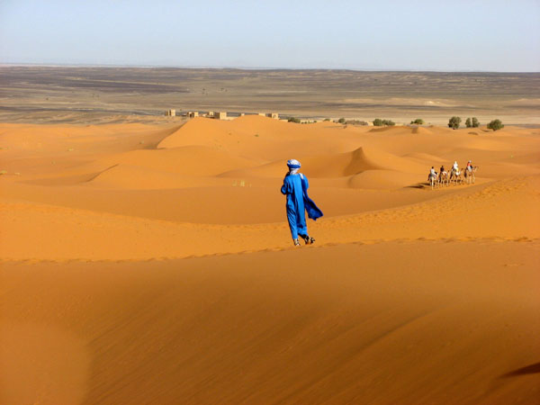
What is Africa like?
There are many different landforms in Africa including grasslands, rainforests, savannas, deserts, forests, and mountains.

Slide 4
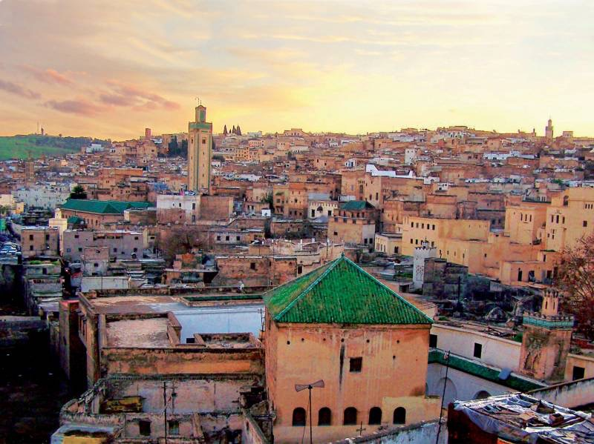
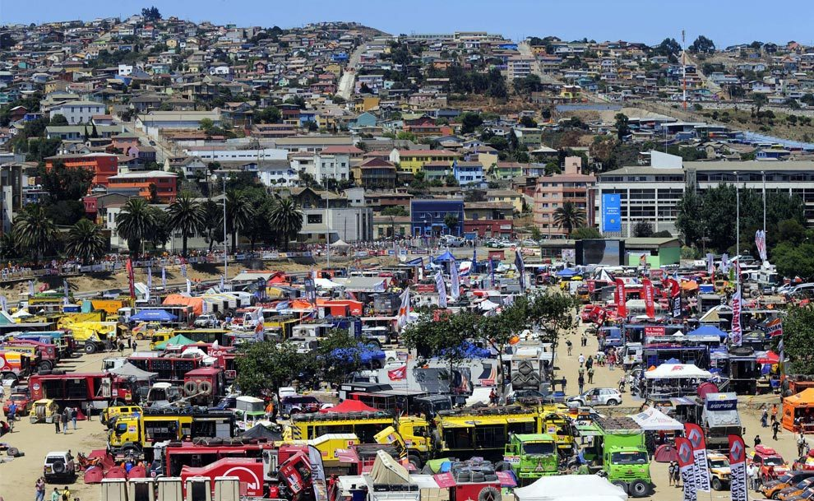
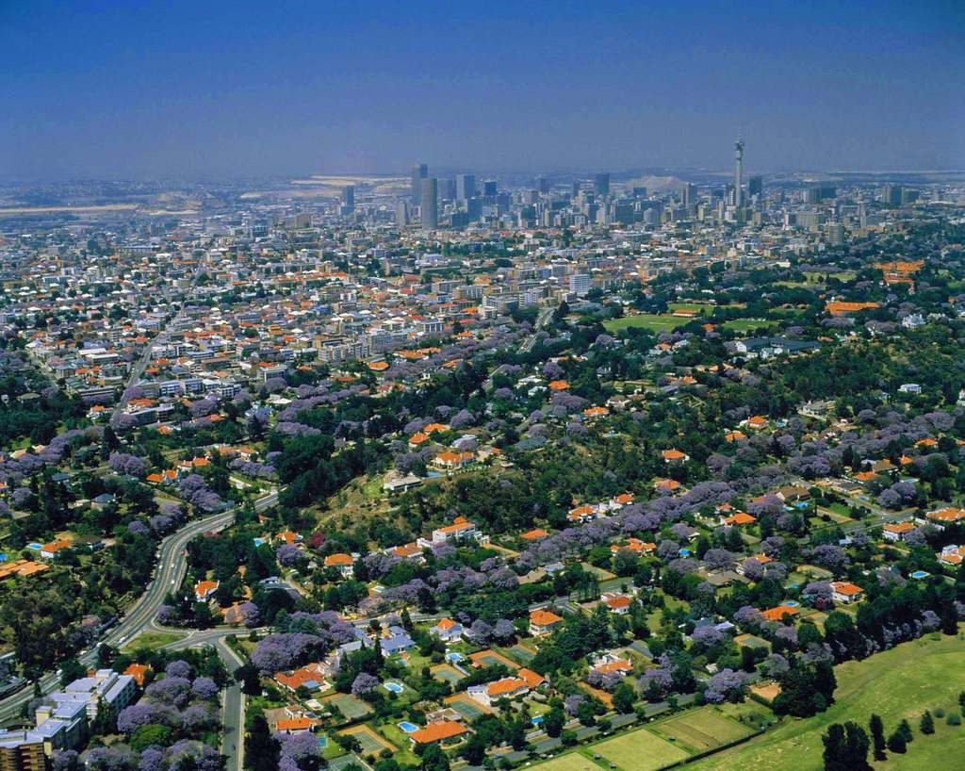
There are also many large modern and old cities in Africa.

Slide 5
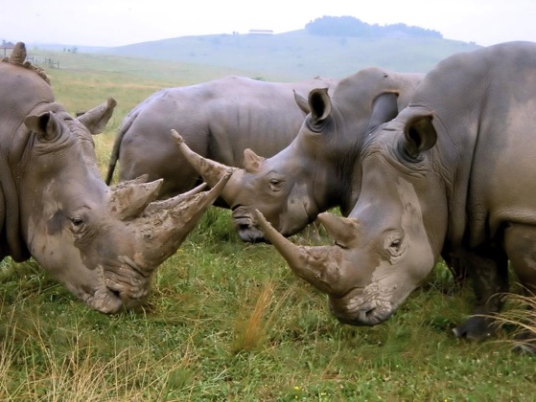
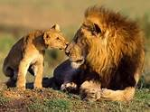
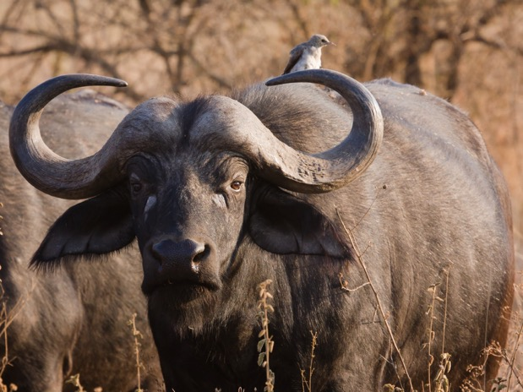
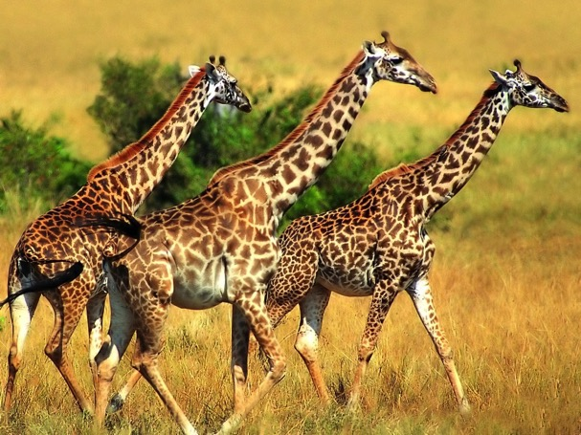
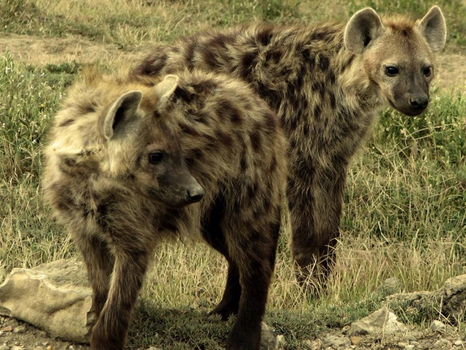
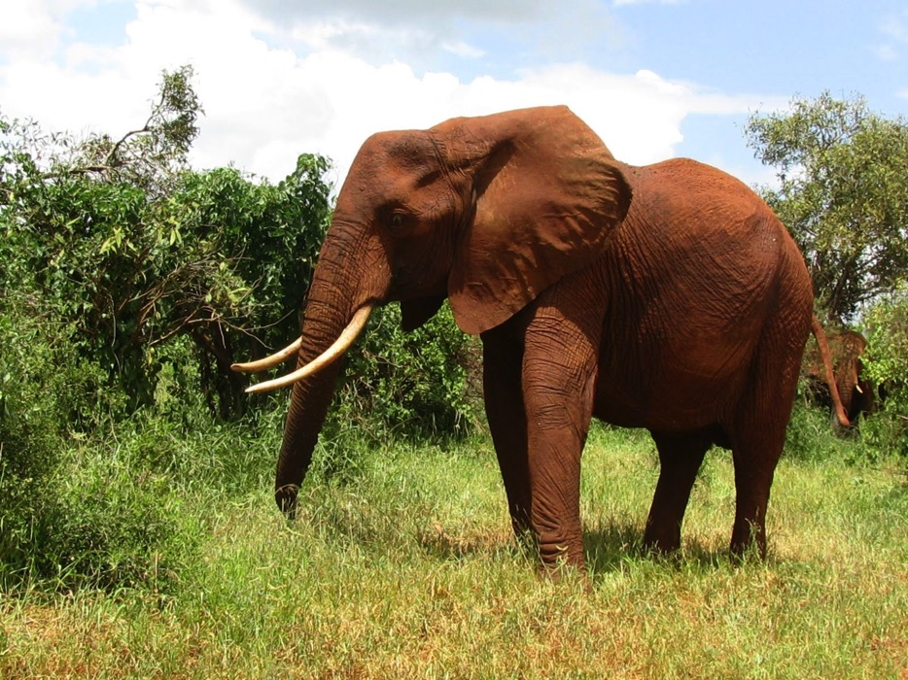
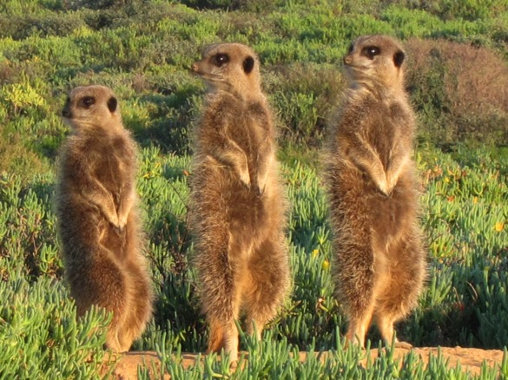
Who lives in Africa?

Slide 6
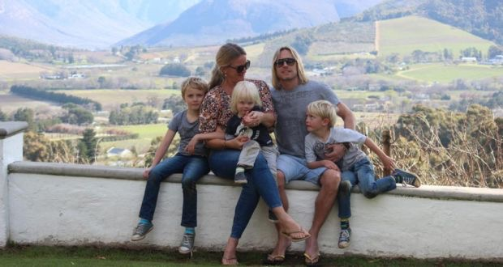
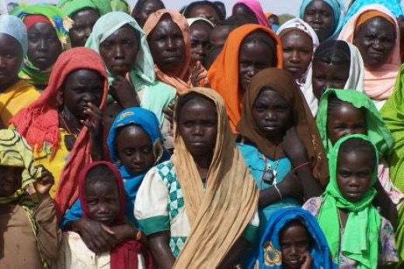
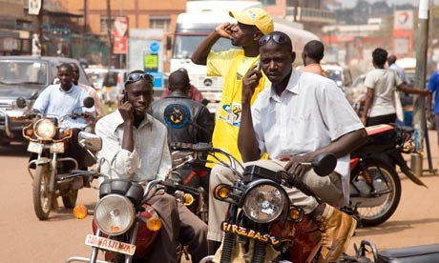
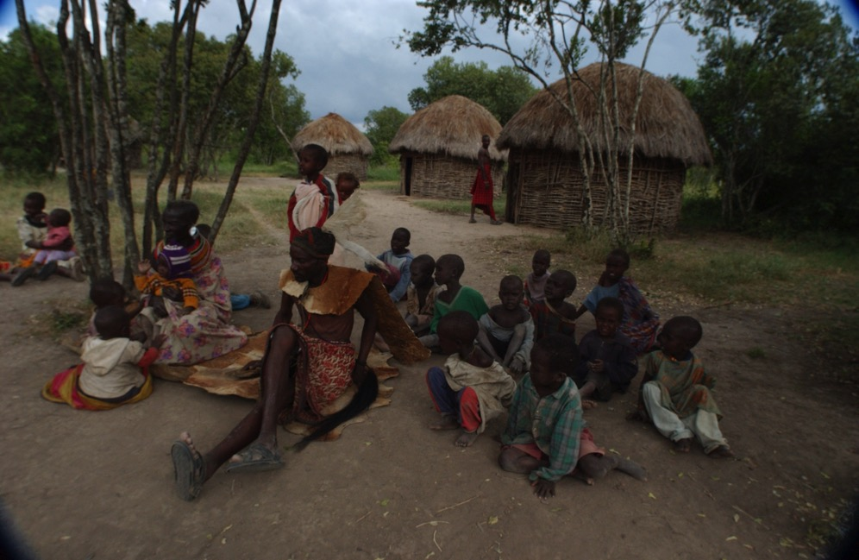
Who lives in Africa?

Slide 7
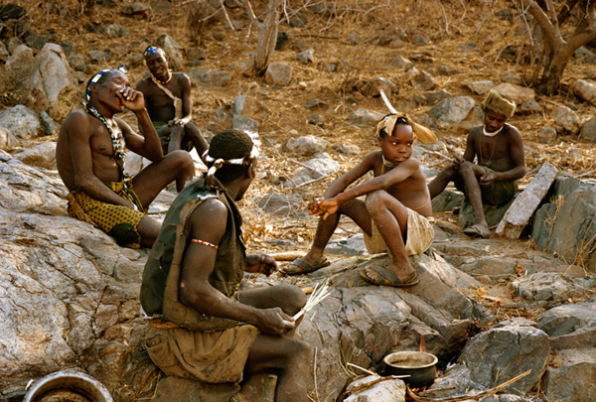
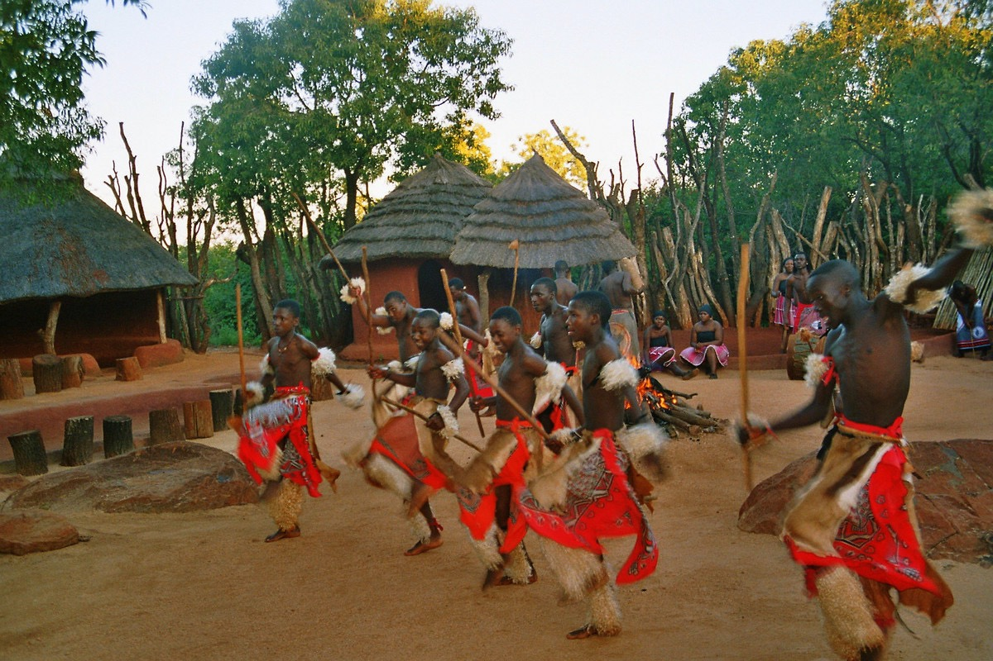
African Tribes
While many people live modern lives, there are still groups of people who live in tribes.
Tribes are a group of people who share a common race, religion, language, or other characteristic.
They practice a way of life that has been handed down by their ancestors from long ago.

Slide 8
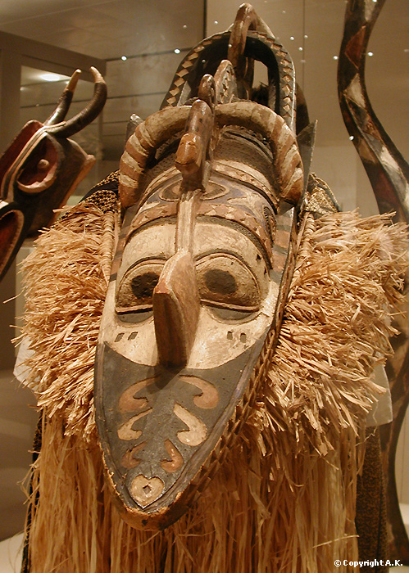
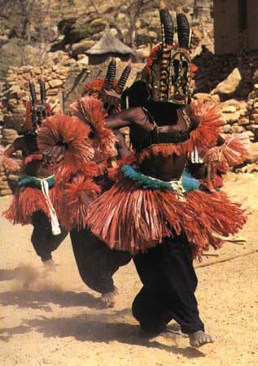
Banda Mask
One custom tribes continue to observe are dance ceremonies. Dance ceremonies are held to celebrate, acknowledge and worship;
birth of a baby
becoming an adult
weddings
funerals
The past
Good crops
Hunting
Deceased Relatives
Nature
spiritual world
Masks are created and worn in the dance ceremonies.

Slide 9
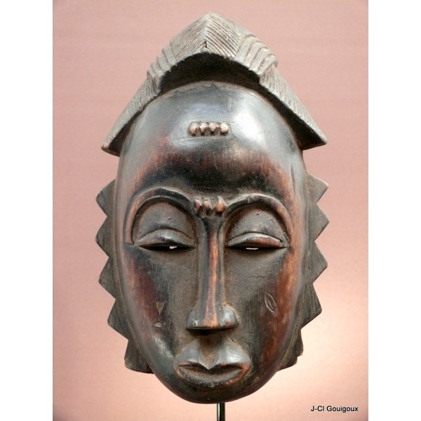
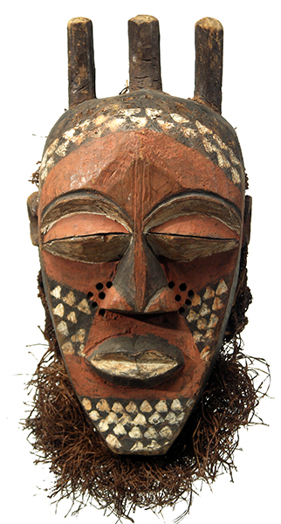
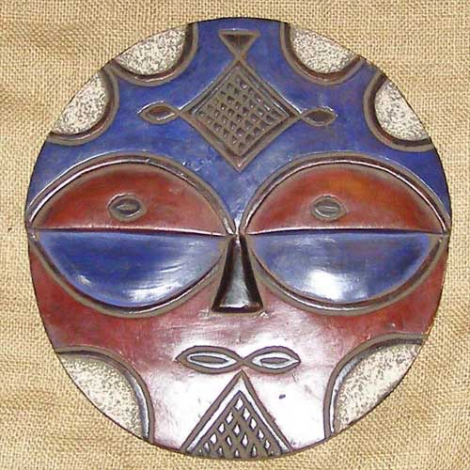
African
Masks
The masks combine…
human features,
animal features,
symmetry,
dimension,
patterning,
and geometric shapes.

Slide 10
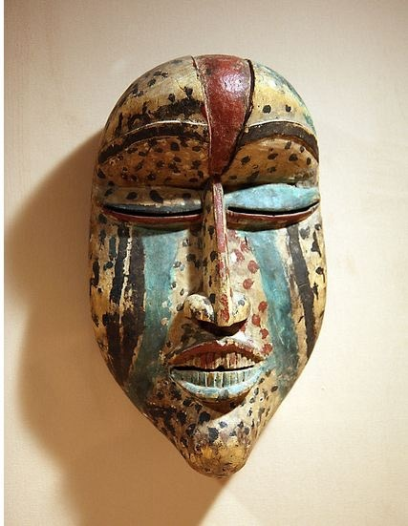
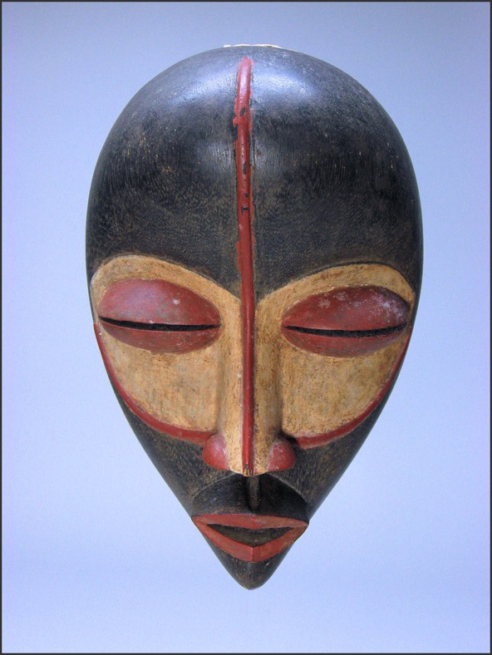
Different features of the mask also represent
different meanings.
large chin and mouths - strength
big forehead -
wisdom
round large eyes -
alertness
checkered patterns - opposites
lines -
paths
Long horns on animals - abundant growth

Slide 11
