Slide 1
The Art Institute of Chicago

Slide 2
The Art Institute of Chicago
The oldest and largest art museum and school in the mid-western United States.
Was established in 1879 as the Chicago Academy of Fine Arts.
It’s predecessor was the Chicago Academy of Design, founded in 1866.
It took it’s current name of the Art Institute of Chicago in 1882.
The Art Institute moved to it’s current building in 1893, and was designed by the architectural firm of Shepley, Rutan, and Coolidge as part of the World’s Columbian Exposition.
The museum has more than 300,000 works of art! Is especially recognized for it’s collection of 19th and 20th century French paintings.

Slide 3
The Art Institute of Chicago
You Tube:
Welcome to the Art Institute of Chicago
http://www.youtube.com/watch?v=4iVp_Rntfqs&feature=player_detailpage

Slide 4
The Art Institute of Chicago – Test Your Knowledge
How old is the Art Museum?
100 years
125 years
130 years
150 years
Who founded the Art Institute?
Mrs. O’Leary’s Cow
The Mayor of Chicago
A famous artist
A group of feisty Chicagoans

Slide 5
The Art Institute of Chicago – Test Your Knowledge
What is an ‘encyclopedic museum”?
Art is categorized by themes and artists
Art represents the whole globe under 1 roof
Pictures of famous artists are in a book for people to look at
What welcomes visitors to the Art Institute?
Scrolls of art
Mrs. O’Leary’s Cow
The Mayor of Chicago
A famous artist
Sculptures of lions

Slide 6
The Art Institute of Chicago – Test Your Knowledge
At the Art Institute you can see:
Paintings
Sculptures
Photographs
Prints
All of the above
The Art Institute has the best collection of what outside of France?
Impressionism
Pointillism
Neo-classical
Americanism

Slide 7
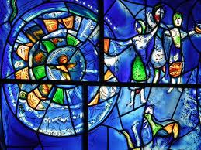
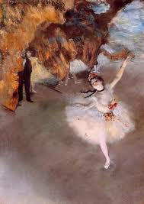
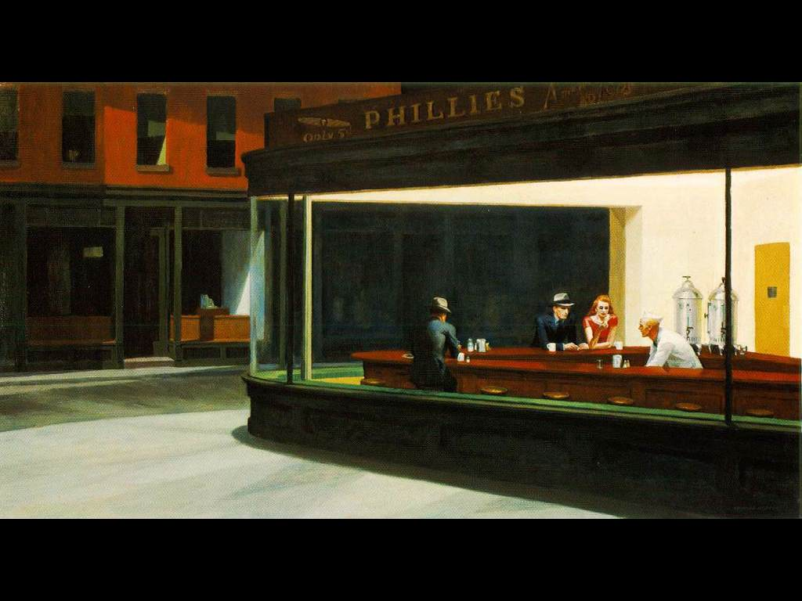
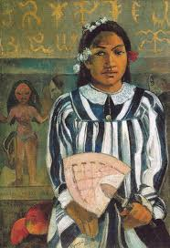
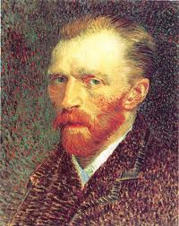
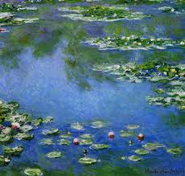
The Art Institute of Chicago – Match the Painting

Slide 8
Georges Seurat (1859-1891)
French neo-impressionist painter who studied art as science. He was a very private man.
Made the technique called pointillism which uses small dots of contrasting color to create his art.
Spent his life studying color theories and the effects of different linear structures.
Born in Paris, studied at the Ecole des Beaux-Arts. Was influenced by Rembrandt and Goya.
He created over 500 drawings, including 7 large paintings, and 60 smaller ones.

Slide 9
A Sunday on La Grande Jatte

Slide 10
Edward Hopper (1882-1967)
American painter who used bright colors to depict ordinary scenes from everyday life.
His paintings were done in a manner to create a somber, melancholy mood.
His work had a “snapshot” like quality to them. Appearing more like a photograph than a painting.
He was born, raised, and studied in New York. Traveled to Europe three times but lived in New York.
Mostly focused on advertising and illustrative etchings until 1924 when took up painting full time.

Slide 11
Nighthawks

Slide 12
Marc Chagall (1887-1985)
Russian born artist who painted everyday objects looking like they were floating in the scene, as if defying the laws of gravity.
Borrowed elements from cubism, impressionism, and fauvism yet developed a style that can not be classified with any movement of his time.
Studied in St. Petersburg and Paris. Returned to Russia in 1914, but left in 1922 as his works had fallen into disfavor with the Soviet Establishment.
America Windows was created to celebrate the U.S. Bicentennial to show his thanks to the U.S. where he had come for safety during World War II.

Slide 13
America Windows

Slide 14
Paul Gauguin (1848-1903)
French post-impressionist painter who liked to paint men and women in their natural, primitive, environment.
Did a majority of his work living in Tahiti and islands in the southern Pacific Ocean.
He sailed around the world for 7 years on freighters and warships. Worked for a stock-broking firm in Paris. Began painting after working in business.
Collected works of many famous painters and studied with Picasso.

Slide 15
Ancestors of Tehamana

Slide 16
Edgar Degas (1834-1917)
French impressionist known for paintings of the human form in motion. Many feature female ballet dancers and bathers.
He found new and brilliant solutions to the problems of form, composition, and color.
He favored pastels.
Born, raised, and studied in Paris at the Ecole Des Beaux-Arts, then traveled to Italy to study.
Early works were historical paintings of classical subjects, then later contemporary city life scenes, then artist Eduoard Manet introduced him to Impressionism.
He preferred indoor scenes over landscapes and preferred lighter scenes with firm lines.

Slide 17
The Star

Slide 18
Claude Monet (1840-1926)
French, Paris born artist and leader of the 19th century impressionist art movement.
He liked to painted outdoor scenes, trying to capture the changing effects of light.
Spent many years struggling as an artist financially and didn’t begin to enjoy financial success until 1886 as the market for his works grew in the U.S.
Instead of mixing colors on his palette, he applied separate strokes of pure, unmixed color directly to the canvas.
Critics often remarked his work looked “unfinished” due to this free style.

Slide 19
Water Lilies

Slide 20
Vincent Van Gogh (1853-1890)
Dutch post-impressionist painter who produced more than 1500 paintings and drawings during his life.
Sadly he only sold ONE painting during his lifetime. It was not until after his death he became known as one of the world’s greatest painters.
Studied drawing in Brussels and used oil paints as his medium.
Was a very solitary man who struggled with poverty and mental illness.
It was after a quarrel with Paul Gauguin that he cut off his left ear.

Slide 21
Vincent Van Gogh Self Portrait

Slide 22
The Bedroom

Slide 23
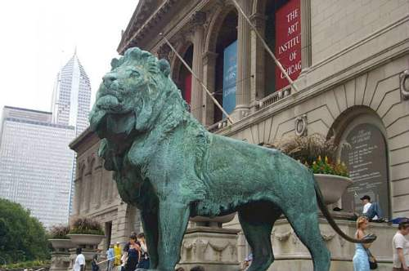
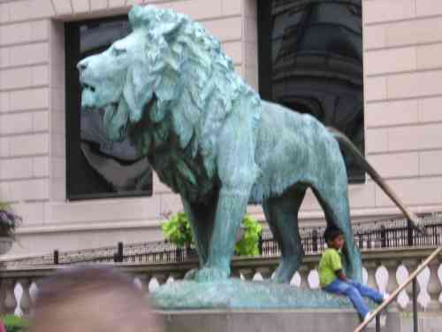
The Project – Drawing your own Welcome Structure
Flanking the entrance to the Art Institute of Chicago, Edward Kemeys' lions are among the city’s most beloved and recognizable sculptures.
Kemeys said that the lions were "conceived as guarding the building.”
You'll notice that the lions are not identical and thus are named for their poses:
The south lion "stands in an attitude of defiance,"
While the north lion is "on the prowl.“
If you could create a sculpture that would welcome people to your house……
What would it look like?
What would you name it?
Draw a picture of your sculpture
We will ask for volunteers to share their art with the class

Slide 24
Resources
Information within this presentation was found in the Encyclopedia Britannica Online Library Edition and Google Images.

