Slide 1
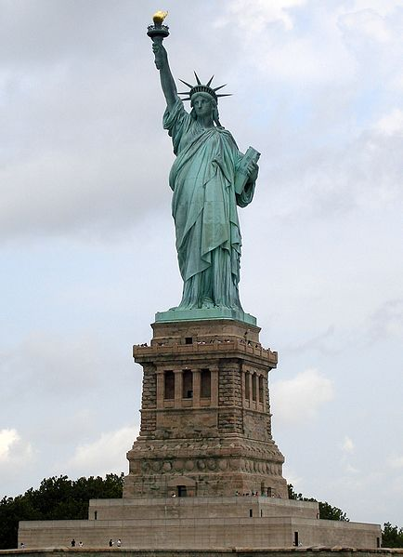
Statue of Liberty
Neoclassical sculpture on Liberty Island in New York (south of Ellis Island)
Gift to the U.S. from France, dedicated in 1886
Symbol of freedom
Designer Frederic Bartholdi and Engineer Gustave Eiffel created an iron support structure with copper skin
Interior framework included two spiral staircases for visitors

Slide 2
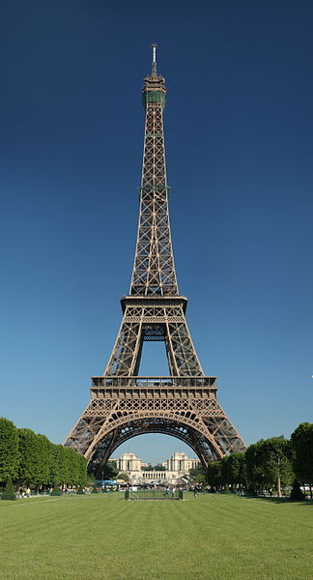
Eiffel Tower
This iron tower is located in Paris and is named after designer/engineer Gustave Eiffel
It was built as the entrance arch to the 1889 World’s Fair
Eiffel Tower is 1,063 feet tall (compared to John Hancock in Chicago: 1,127 feet tall)
Internal access for visitors via stairs and elevator - Two restaurants
More than 200,000,000 people have visited the Eiffel Tower since its construction in 1889

