Slide 1
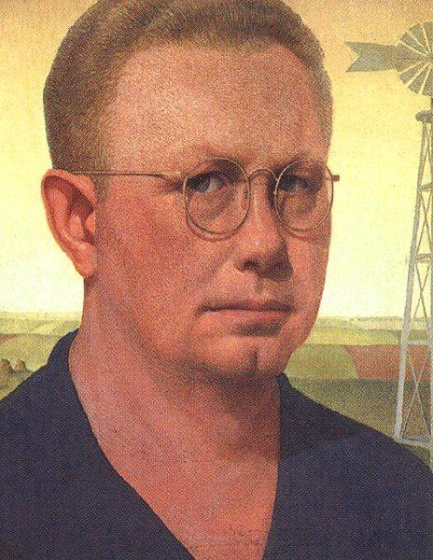
Grant Wood
Notes:
Self portrait

Slide 2
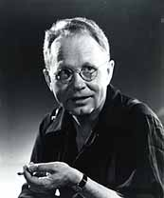
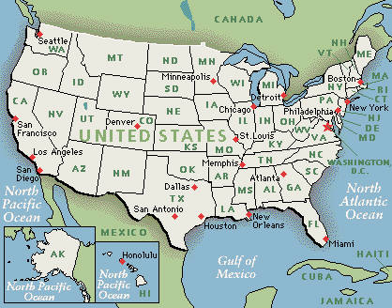
Grant Wood
Born February 13, 1891 in Iowa
Best known for paintings showing the rural Midwest

Slide 3
Grant Wood
At age 3, he started drawing pictures of chickens
When he was 14, he won 3rd prize in a national contest for a crayon drawing of oak leaves
Said that winning that prize was his inspiration to become an artist.
Notes:
As Wood's work became known, his paintings began to sell for modest prices in the vicinity of $300. His most famous work, "American Gothic" was painted in 1931 and was sold to the Chicago Art Institute at this price, though it is priceless today.

Slide 4
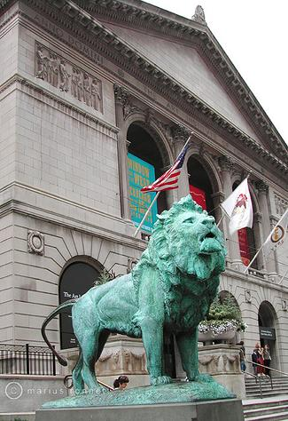
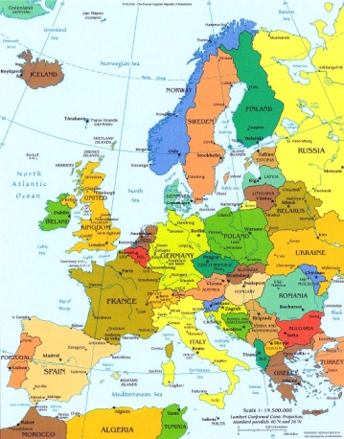
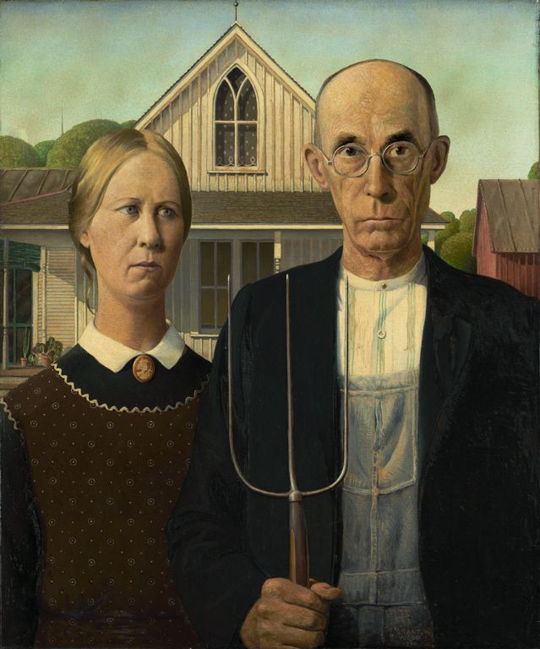
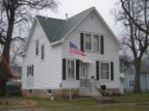
Timeline
Student at Art Institute of Chicago
Traveled to Europe to Study Painting
Won $300 in Art Contest
Born in Iowa
Taught Art at University of Iowa
Died of Cancer
1891
1913
1920
1928
1930
1934
1941
1942
Notes:
As Wood's work became known, his paintings began to sell for modest prices in the vicinity of $300. His most famous work, "American Gothic" was painted in 1931 and was sold to the Chicago Art Institute at this price, though it is priceless today.

Slide 5
Grant Wood American Gothic, 1930
Notes:
Where do you think this was painted? (American Gothic was painted in Eldon, Iowa -about 5 hours from Arlington Heights)
Where do you think the artist was standing when he painted it?
What type of colors did he use?
When do you think it is? (Around the time of the great depression)
What are they doing? Are they posing?
Whom do we see here? (He asked his dentist and his sister Nan to pose as a farmer and his unmarried daughter)
Why do you think artist painted the people looking serious? (b/c farm life was very hard.)
*The upper window designed to resemble a medieval/gothic pointed arch, inspired the painting’s title
Where the people stood, testifies to the association Americans have with their homes as expressions of themselves. In rural America, a home not only signified family but also the mutual hard work of its members, and as the family’s greatest financial possession.

Slide 6
American Gothic house in Eldon, IA
They are standing in front of an Iowan farmhouse built in the Carpenter Gothic style that Sears, Roebuck and Co. used to sell as kits, hence the "Gothic" part of the title.
Notes:
One day, while Grant was looking for something interesting to paint, he discovered a farmhouse with an unusual window. The arch-shaped window was based on a style of European architecture from the Middle Ages called Gothic architecture. Grant liked the contrast of a European window on an American farmhouse.

Slide 7
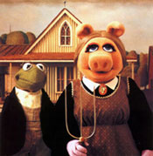
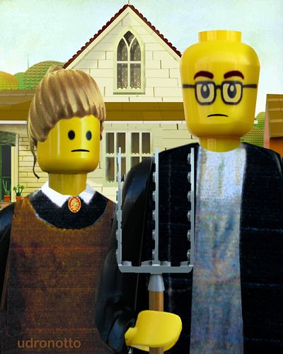
Parody
Notes:
Parody – Copying someone’s work in a comical way. Often meant to be ridiculous. A humorous imitation that changes the tone of a famous work.
The students have learned the background history of Grant Wood's "American Gothic." Then the students viewed a few artists who have created parodies to the American Gothic Idea. We talked about what is always the same, the roles of the two people in the painting and how they might have changed today. A parody is a

Slide 8
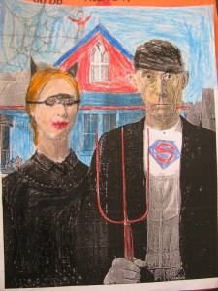
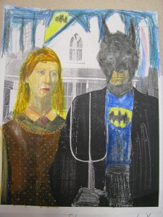
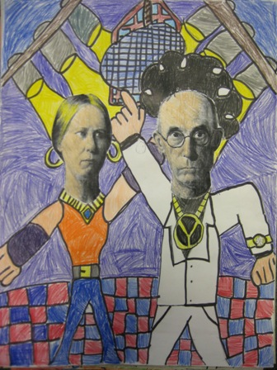

Slide 9
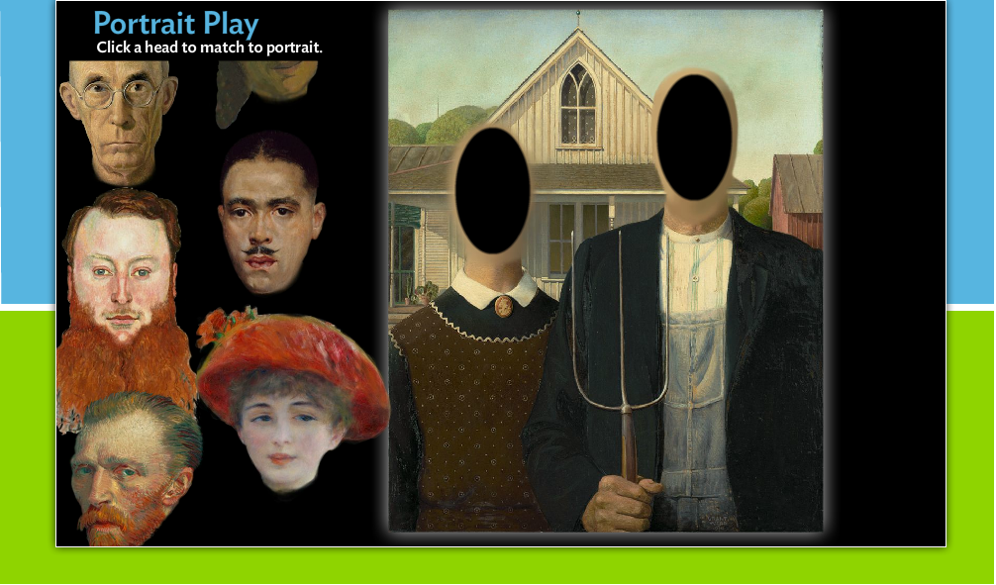
For more info on art and educational art games go to: http://www.artic.edu/aic/education/CC/index.html

