Slide 1
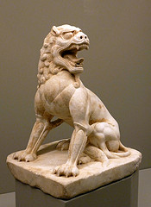
Guardian Lion Stylization & Symbolism
Notes:
What does this look like?

Slide 2
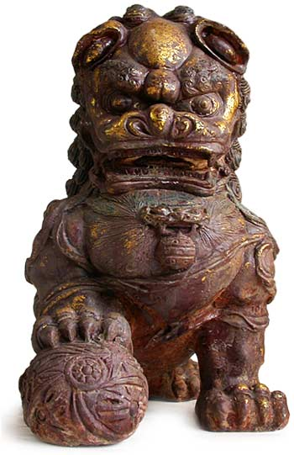
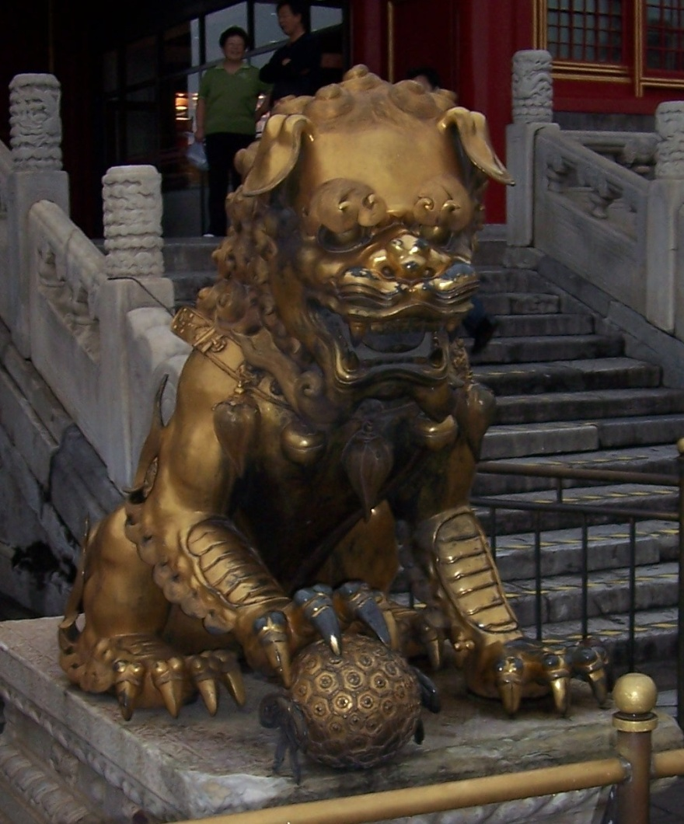
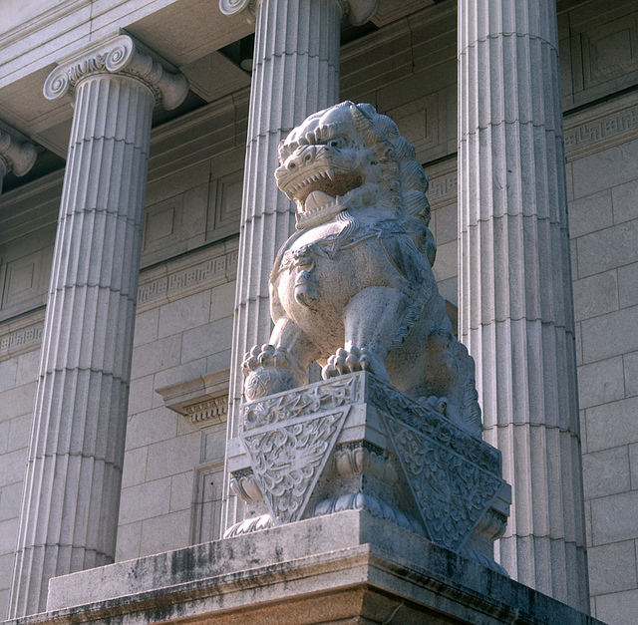
Guardian Lion
Notes:
What country do you think these sculptures come from? (China)
When do you think they were made? (1st made over 2,000 years ago)
What materials do you think they were made out of? (marble, stone, granite, cast in bronze or iron)
What else is interesting about the sculpture: Does it look real? What type of feeling would you associate with the lion?

Slide 3
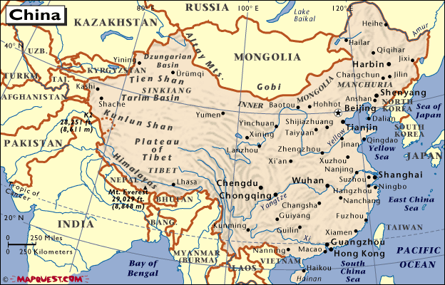
Origin
Notes:
Origin – The place where it comes from
This particular “Guardian Lion” came from the Chinese providence of Hopei (highly populated area of NE China) over 1,000 years ago. Was carved from stone.
You can find different types of Guardian Lion’s throughout China
Came from Buddhist religion, whose god was Buddha. Buddha was said to be a lion among men and spoke with the voice of a lion. His throne is guarded by 2 lions.
Buddhist religion was founded in India and spread across Asia (China).
Buddhism consists of a lot of symbolism. That is why lion sculptures are very popular in China.

Slide 4
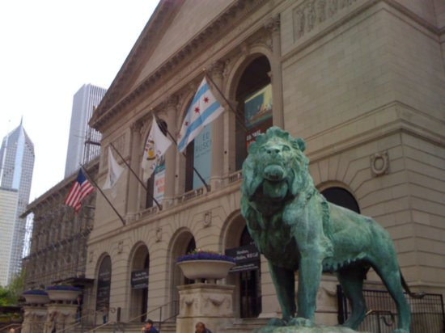
Realism vs Stylization
Notes:
There are many ways artists can depict the world around them.
Present objects in a Realistic way: The way your eye actually sees things in nature. Make it look real.
Present objects through Stylization: Representing the general idea of the object, but making many of the areas of the object decorative.
Does this look familiar?

Slide 5
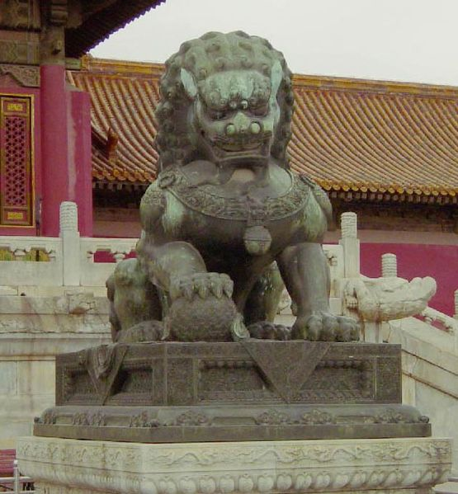
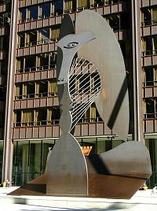
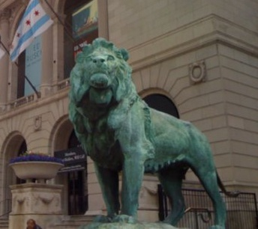
Realism vs Stylization
Realism
Stylization
Notes:
Picasso – Abstract, didn’t look at all real. Chicago – Baboon Head

Slide 6
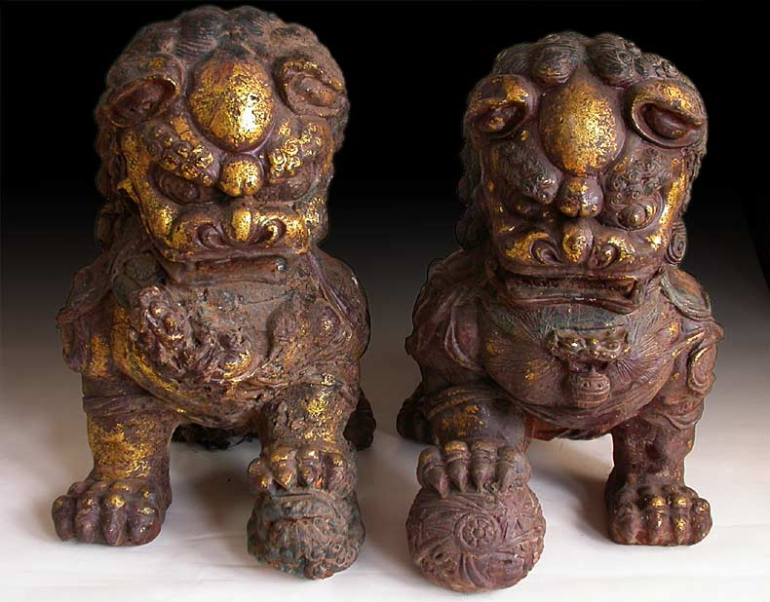
Symbolism
Notes:
Lions symbolized protection. Often pairs of lions are found outside the entrance of buildings, palaces, and homes to “guard” the structure. Smaller lions could be found inside buildings to “protect” an important area, such as a tomb.
Pairs of lions are still often used as decorative or symbolic elements in front of restaurants, hotels, and some homes.
Symbolism – Representing things by symbols or having symbolic meaning. (More to it than what you see. Other meanings.) You will often find them in pairs, as shown. 1 male – With paw on a ball, 1 female – With paw on a cub lion. Symbolically, the male guards the structure and the female protects those inside.

Slide 8
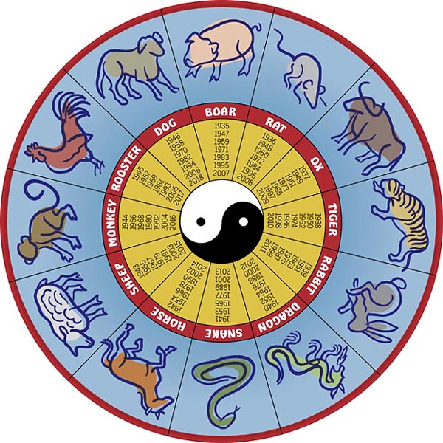
Chinese Calendar
Notes:
China is known for using a lot of symbolism in their life. Again, much of this came from the early days of Buddhism.
The Chinese believe the animal ruling the year in which a person is born has a profound influence on personality, saying: "This is the animal that hides in your heart.“
2001: Year of the Snake - People born in the year of the Snake are romantic and deep-thinking, wise and charming, although they tend to dismiss others too quickly and are a bit stingy with money. Ideal jobs include teaching or psychiatry
2000: Year of the Dragon - Dragons tend to be popular individuals who are always full of life and enthusiasm, with a reputation for being fun-loving. They make good priests, artists and politicians.

Slide 9
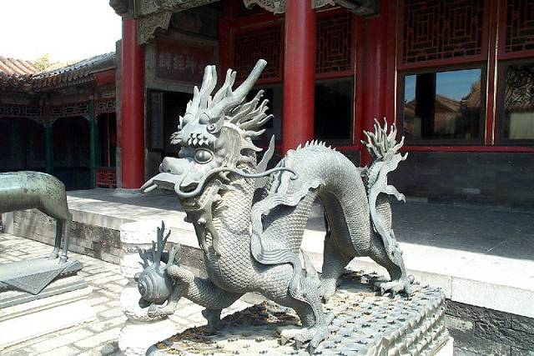
Chinese Dragon
Notes:
Dragons are legendary creatures in Chinese history. Folktales speak of the dragon having all the attributes of the other 11 creatures of the zodiac, this includes the whiskers of the rat, the face and horns of an ox, claws and teeth of a tiger, belly of a rabbit, body of a snake, legs of a horse, the beard of a goat, wit(or brain) of a monkey, crest of a rooster, ears of a dog, the snout of a pig.
The Celestial Chinese Dragon is comparable as the symbol of the Chinese race itself. Chinese around the world, proudly proclaim themselves "Lung Tik Chuan Ren" (Descendents of the Dragon). Dragons are referred to as the divine mythical creature that brings with it ultimate abundance, prosperity and good fortune.
As the emblem of the Emperor and the Imperial command, the legend of the Chinese Dragon permeates the ancient Chinese civilization and shaped their culture until today. Its benevolence signifies greatness, goodness and blessings.
The Chinese Dragon symbolizes power and excellence, valiancy and boldness, heroism and perseverance, nobility and divinity. A dragon overcomes obstacles until success is his. He is energetic, decisive, optimistic, intelligent and ambitious.
Unlike the negative energies associated with Western Dragons, most Eastern Dragons are beautiful, friendly, and wise. They are the angels of the Orient. Instead of being hated, they are loved and worshipped. Temples and shrines have been built to honor them, for they were considered the rulers of water and weather.
Where do you think this sculpture falls on the Realism – Stylization scale? What are the decorative features?

Slide 10
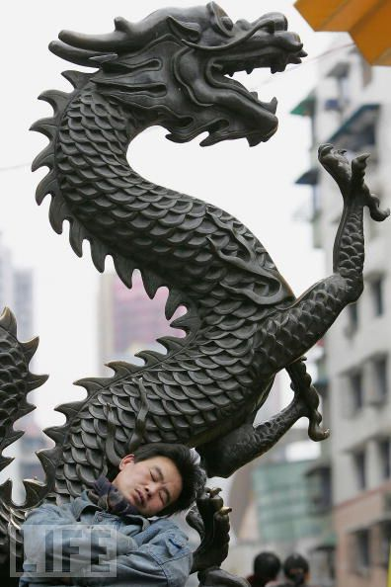

Slide 11
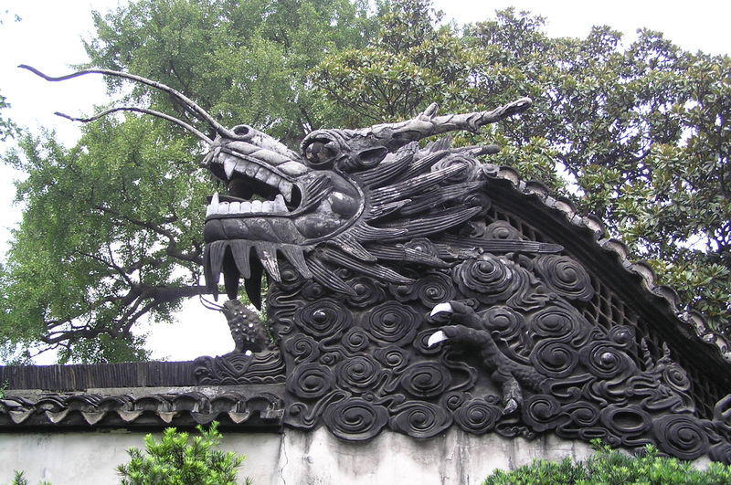
Notes:
Realism vs Stylization

Slide 12
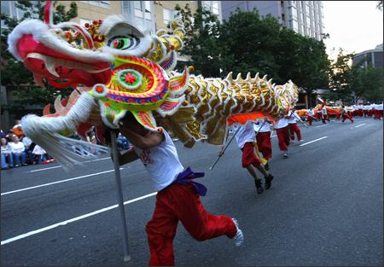
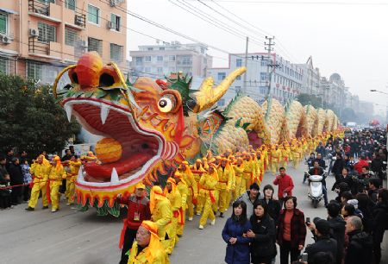
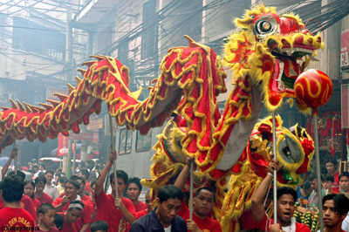
Notes:
Dragons are a symbol in Chinese festive celebrations. The dragons are believed to bring good luck to the people.
Plus, it is probably very fun to dance around and move and act like a dragon. Often these dragons are over 100 feet long.

Slide 13
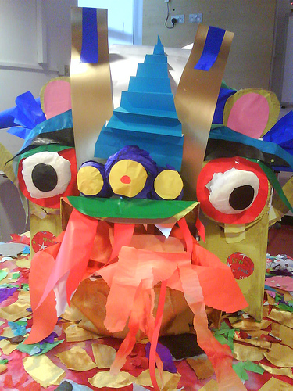
Craft Time

