Slide 1
MODERN ART
Wassily Kandinsky
Paul Klee

Slide 2
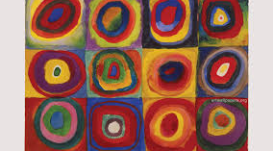
Squares with Concentric Circles Wassily Kandinsky 1913

Slide 3
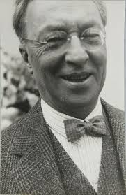
Facts about Wassily Kandinsky 1866 - 1944
Born in Moscow, Russia
Studied piano and cello
Graduated law school from the University of Moscow with honors in 1886
Took a position on the Moscow Faculty of Law in 1892 (managed an art printing business also then)
Spoke German as well as Russian
Studied at the Academy of Fine Arts in Munich
Over his lifetime he lived in Russia, Germany, and France

Slide 4
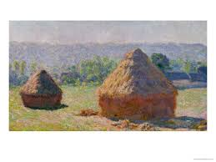
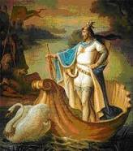
Two influences in 1892 caused him to change his career to an artist…
Claude Monet’s
Haystacks at Giverny
Richard Wagner’s Opera
Lohengrin

Slide 5
Important aspects of Kandinsky’s works
Most of his art study was self-directed
Began with conventional themes and art forms, but developed theories of his own derived from spiritual study and the relationship between music and color
He used color as an expression of emotion instead of as a faithful description of something
He and Paul Klee were friends
He has books published on his ideas on theories of art
He is often referred to as the father of abstract art
Most of the work he created in Russia did not survive

Slide 6
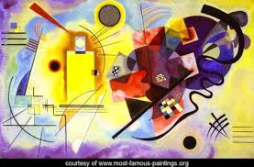
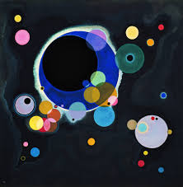
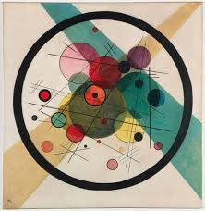
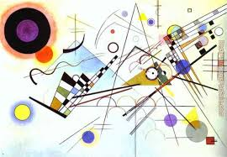
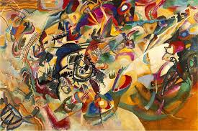
Other works by Kandinsky
Circles in a Circle, 1923
Yellow, Red, Blue 1925
Several Circles, 1926
Composition VIII, 1923
Composition VII, 1913

Slide 7
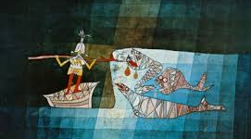
Sinbad the Sailor Paul Klee, 1928

Slide 8
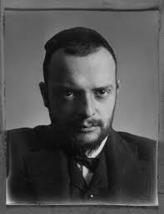
Facts about Paul Klee 1879-1940
He was born in Switzerland
His parents were musicians, he was a violinist invited to study at Bern at age 11
Studied at the Academy of Fine Arts in Munich in 1898
Met Kandinsky in 1911 and traveled to study in France in 1912
Taught at the Bauhaus School in Germany but was forced to leave during WWII
During his lifetime he lived in Switzerland, Italy, Germany, and France

Slide 9
Important aspects of Klee’s works
His work was influenced by cubism, expressionism, and surrealism
He and Kandinsky formed the Blue Four with Alexej von Jawlensky and Lyonel Feininger which toured the United States with lectures and exhibits
He often drew with a needle on a blackened pane of glass (his signature technique)
His paintings are often referred as “childlike”
He finished more than 9000 pieces of work in his lifetime

Slide 10
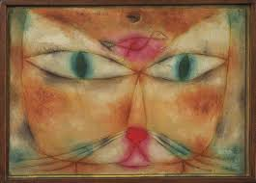
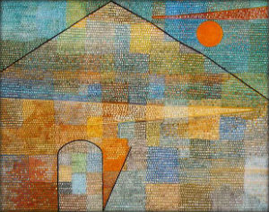
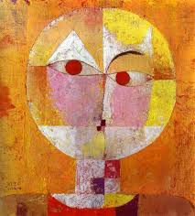
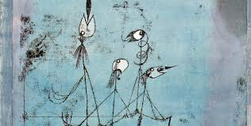
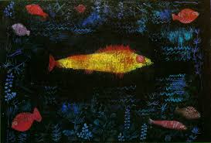
Other works by Paul Klee
Cat and Bird, 1928
Ad Parnassum, 1932
Senecio, 1922
Twittering Machine, 1922
Der Goldfisch, 1925

Slide 11
PROJECT To create our own version of Squares with Concentric Circles using oil pastels on paper. Will create while listening to the Overture from the opera Lohengrin. Just as Kandinsky was inspired.

