Slide 1
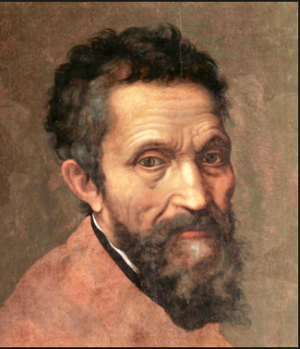
Michelangelo
Sculptor
Painter
Architect
Poet

Slide 2
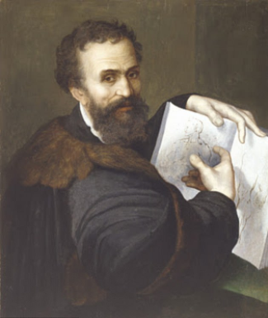
About the Artist
Born in Italy in 1475 - over 540 years ago!
Michelangelo di Lodovico Buonarroti Simoni – whew!
Considered one of the greatest artists of all time
Started at age 14
Practiced many forms of art
Sculptor
Painter
Architect
Poet

Slide 3
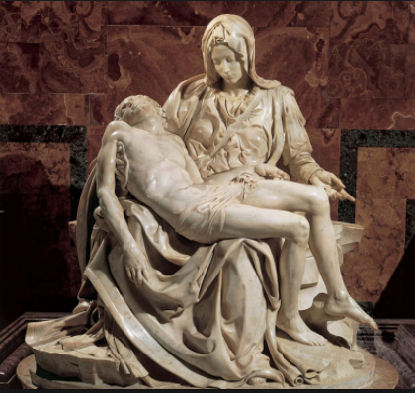
The Pieta Statue (pronounced Pity)
Created at age of 24
Carved from Marble
Located in Rome, Italy
The sculpture made him famous and he received praise from around the world
People were amazed by the details

Slide 4
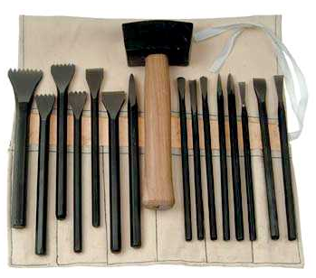
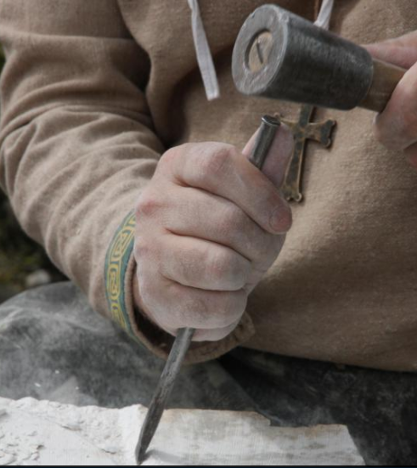
Tools Used

Slide 5
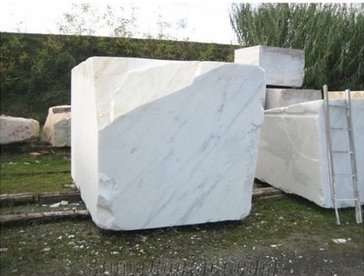
Material Used giant pieces of heavy stone

Slide 6
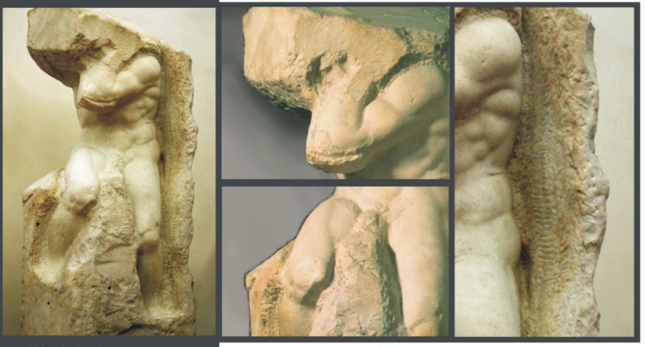
Michelangelo the Sculptor
“Every block of stone has a statue inside of it and it is the task of the sculptor to discover it” - Michelangelo

Slide 7
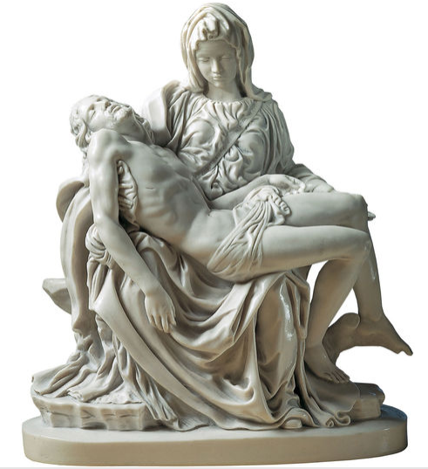
This statue is bigger than real people!

Slide 8
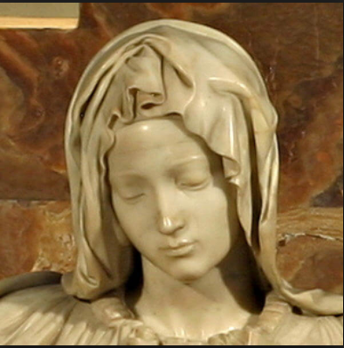
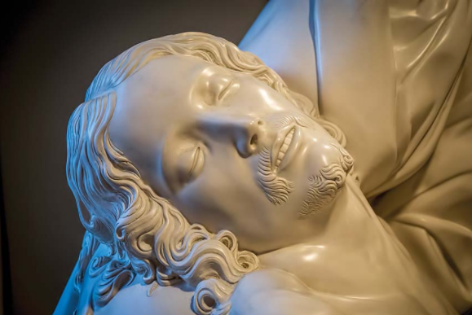
Very realistic for stone!

Slide 9
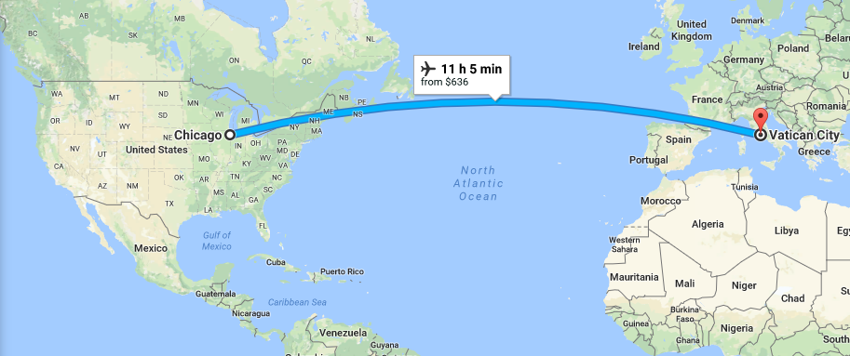
Sistine Chapel
4,805 miles from Arlington Heights

Slide 10
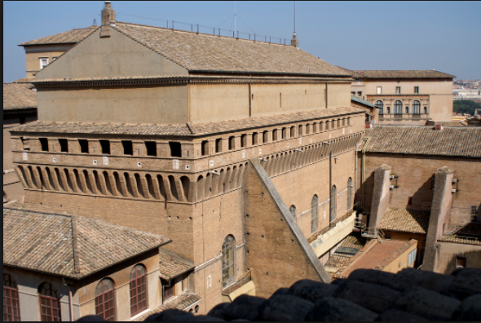
Sistine Chapel
Built in 1479 and completed in 1481
Vatican City, Italy
Church of the Pope
Plain on outside - common

Slide 11
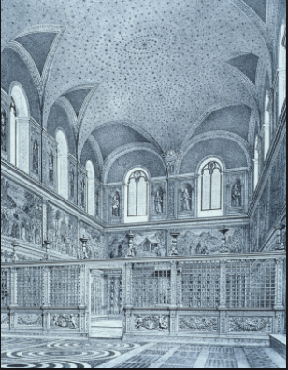
Original Inside of Sistine Chapel
Ceiling - blue with gold stars
In 1508 - Pope Julius II wanted a change
Requested Michelangelo help
Michelangelo really had to think about it – he prided himself as a sculptor – not a painter!

Slide 12
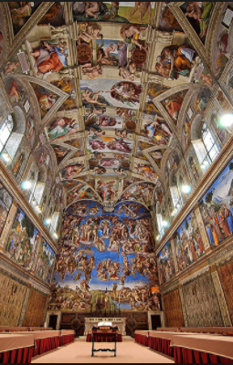
He Says Yes
Originally, Pope wanted just a small area of the ceiling painted
Michelangelo convinced him to let him paint the whole thing
So he got to work – it took him 4 years to finish it!
It has over 300 people and no two are alike.

Slide 13
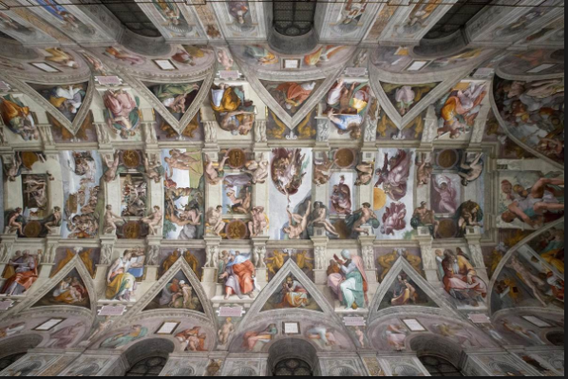

Slide 14
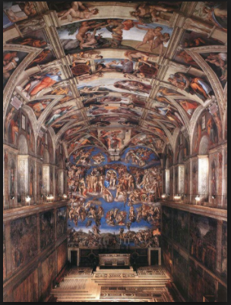
See the door?
This place is huge!

Slide 15
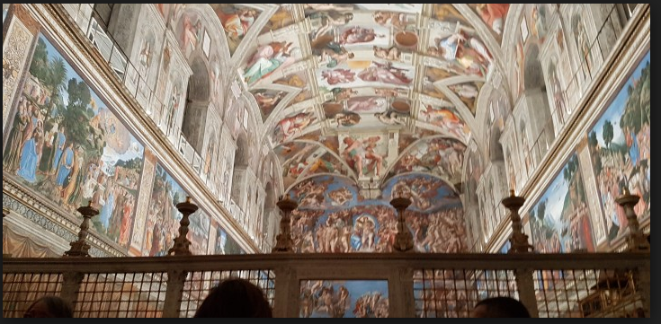

Slide 16
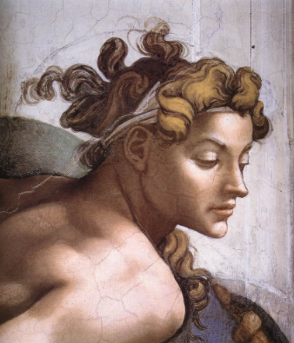
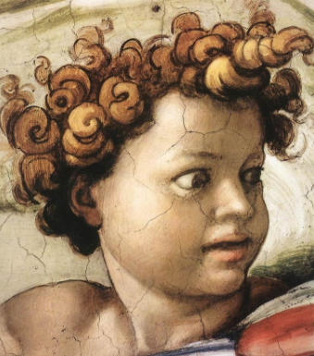
He was known for showing expression in his works
What do you think they are thinking?

Slide 17
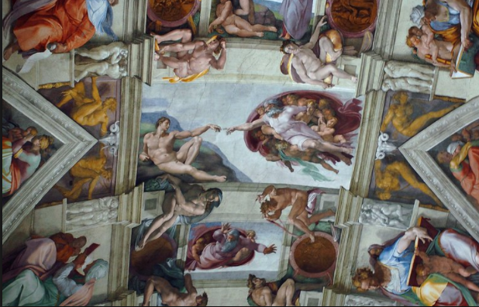

Slide 18
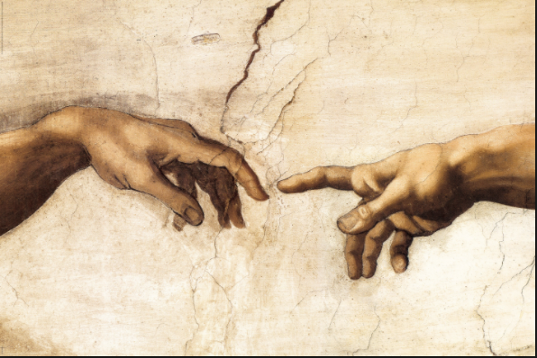

Slide 19
How did he do it?
Built wooden scaffolding to allow him to stand upright and reach about his head
65 feet off the ground - that is like the 6th floor of a building!
Rarely came down - focused only on his work
Ate and even slept up there!
It took him 4 years to finish this project!

Slide 20
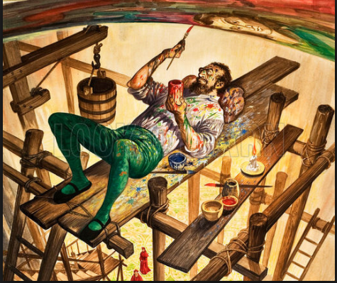

Slide 21
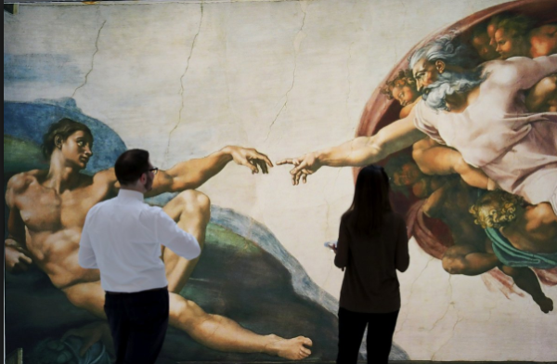
Up Close exhibit -New York - lets people see the paintings up close and in detail

Slide 22
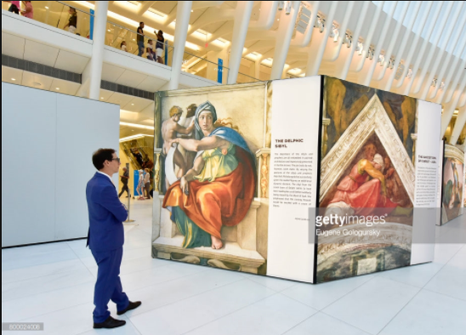
Up Close -New York

Slide 23
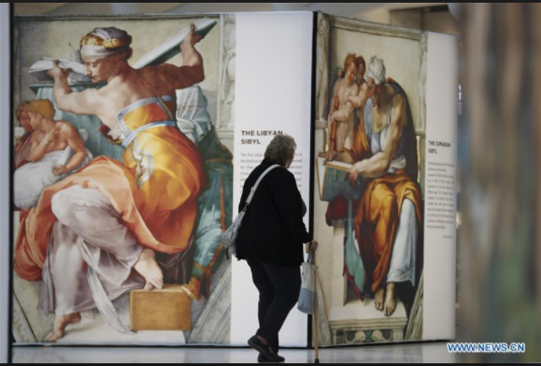
Up Close -New York

Slide 24
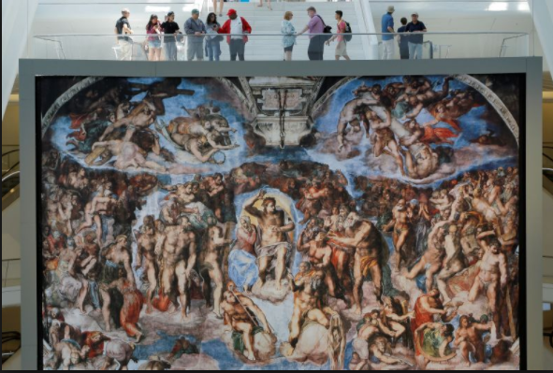
Up Close - New York

Slide 25
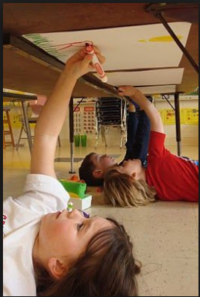
Let’s be an artist!
Create a picture of a scene
Maybe a party? A classroom? Recess time?
Be as detailed as you can!
Include people, animals etc.

Slide 26
How did your picture turn out?
How did your arms feel?
Was it easy?

Slide 27
We hope you enjoyed learning all about Michelangelo!
Thank you!

